Slide 1
SPEAKER GUIDANCE—REMOVE THIS SLIDE
100-Level Introduction to AWS Machine Learning:
The following set of slides are meant for a 15-minute introduction conversation to both machine learning and AWS’s ML approach and technology.
These slides should be used for an initial conversation with a customer or any conversation with a non-technical leader.

Slide 2
AWS Machine Learning
Notes:
First call deck for introduction to Amazon Machine Learning

Slide 3
What is it?
Artificial intelligence
Any technique that enables computers to mimic human intelligence using logic, if-then statements, and ML (including deep learning)
Machine learning
Subset of AI that uses machines to search for patterns in data to build logic models automatically
Deep learning
Subset of ML composed of deeply multi-layered neural networks that perform tasks like speech and image recognition
Notes:
You’ve probably heard these technologies described in a number of ways so let’s take a step back to level-set on what they are.
AI is a way to describe any system that can replicate tasks that previously required human intelligence.
Almost always, this is related to some kind of complex decision making where human judgment would be required. Most uses cases for AI are looking for a probabilistic outcome – making a prediction or decision with a high degree of certainty, similar to human judgement.
Almost all AI systems today are created using machine learning, which uses large amounts of data to create and validate decision logic, known as a model. The AI application then feeds input data into that model, and the model outputs human-like decisions. So machine learning is the underlying technology that is powering intelligent systems.
Deep Learning is a type of machine learning that uses a technique known as deep neural networks. These systems replicate how the human brain functions. This lets AI systems address more complex uses cases than was previously possible.

Slide 4
The reach of ML is growing
INCREASED SPENDING
FROM PILOTING TO OPERATIONALIZING
AI TRANSFORMATION
By 2021, global spending on AI and cognitive technologies will exceed $50 billion
—IDC
By the end of 2024, 75% of enterprises will shift from piloting to operationalizing AI
—Gartner
57% said that AI would transform their organization in the next three years
—Deloitte
Notes:
Machine learning went from being an aspirational technology to mainstream extremely fast.
For a long time, the technology was limited to a few major tech companies and hardcore academic researchers.
But, things began to change when cloud computing entered the mainstream.
Compute power and data became more available, and quite literally, machine learning is now making an impact across every industry (finance, retail, fashion, real estate, healthcare etc.).
It’s moving from the peripheral to now a core part of every business and industry.
https://www.gartner.com/en/newsroom/press-releases/2020-06-22-gartner-identifies-top-10-data-and-analytics-technolo
https://www2.deloitte.com/us/en/insights/focus/cognitive-technologies/state-of-ai-and-intelligent-automation-in-business-survey.html

Slide 5



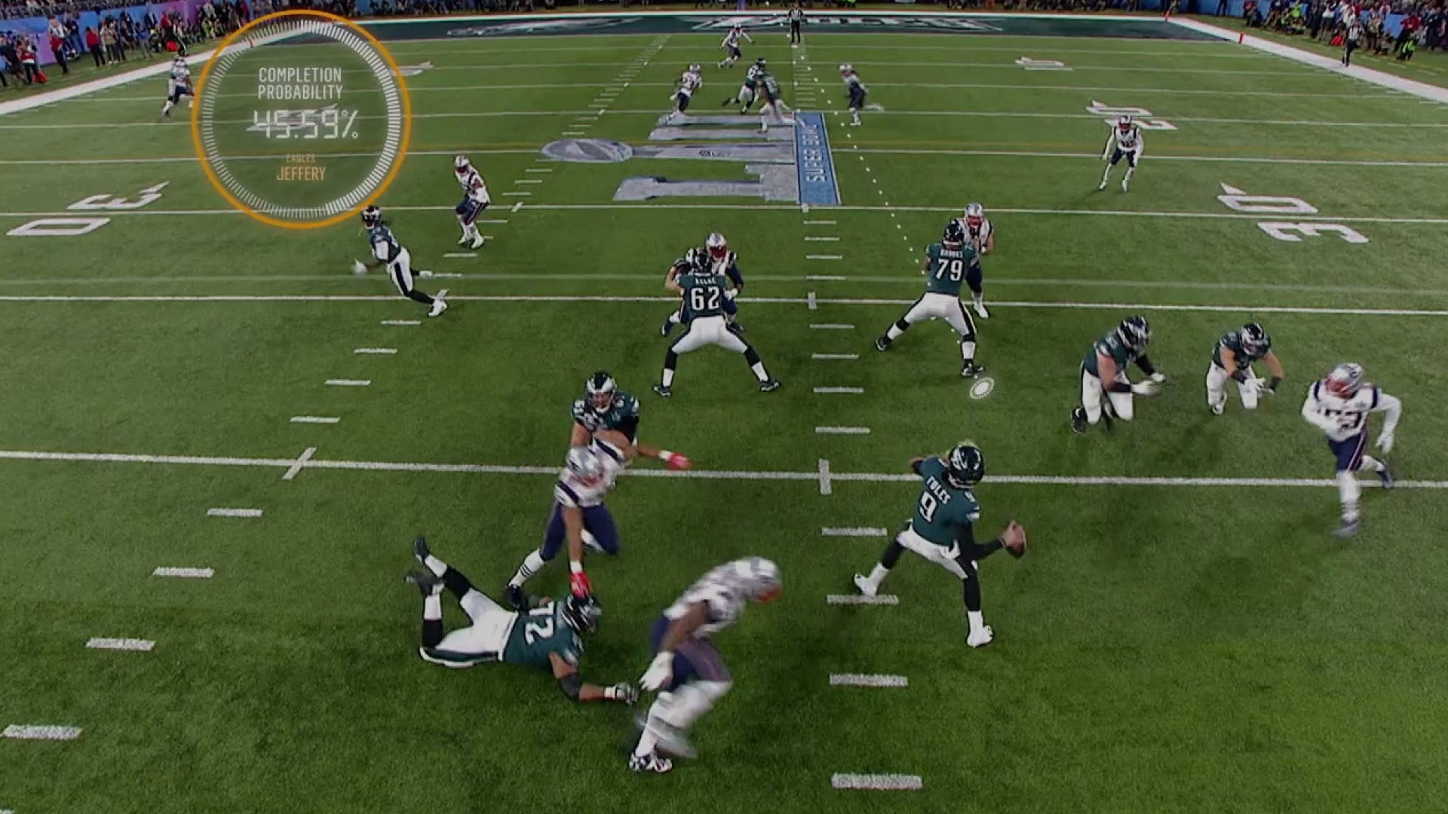
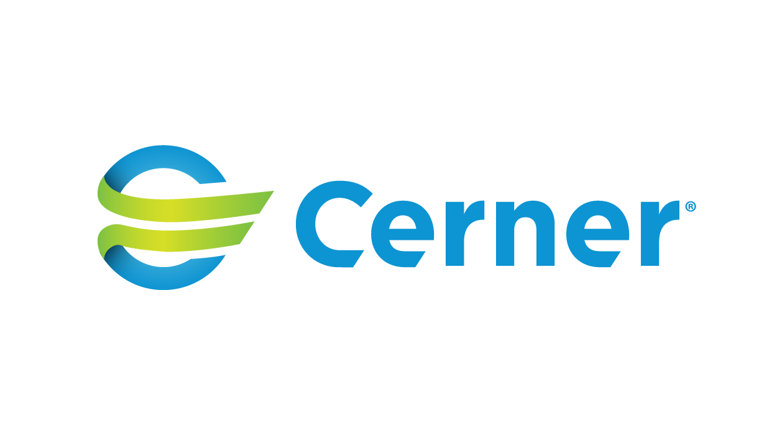



Notes:
Let’s take a look at how our customer are doing this.
In customer experience, Intuit has built forecasting capabilities to predict call center demand on a particular day or time to make sure customer service agents are adequately staffed.
Convoy, a Seattle-based logistics company, is building their entire company and value proposition off the use of machine learning. The company is disrupting the inefficient trucking model by using machine learning to automate it. Convoy uses machine learning to provide better matches for shippers and truckers, allowing them to move freight more efficiently—and lowering costs for both parties—using Convoy’s matching system.
In healthcare, Cerner, an American supplier of health information technology solutions, services, devices, and hardware is tapping into AWS’s deep portfolio of machine learning and AI services including Transcribe Medical to surface insights that will help their healthcare provider customers streamline operations and provide more personalized patient care. They’ve already developed a model that predicts Congestive Heart Failure up to 15 months before clinical manifestation. Pairing this predictive tool with real-time integration in to individual health records can support provider decision making in real-time
And in sports, we’ve been working with the NFL to create Next Gen Stats to engage fans by combining old and new data to reveal insights about game dynamics for both fans and players. We have now developed over 20 unique Next Gen Stats that are used on-screen during games in real time, by broadcasters and partners, online for fans, and more. The most exciting stats use predictive machine learning models built on Amazon SageMaker that highlight the athleticism like never before, and it’s just getting started bringing the data to life.
But, even with the increasing adoption of Machine Learning and much hype associated with the technology, it is still in its infancy.
We are just scratching the surface of the impact that ML can have across industries and geographies.

Slide 6

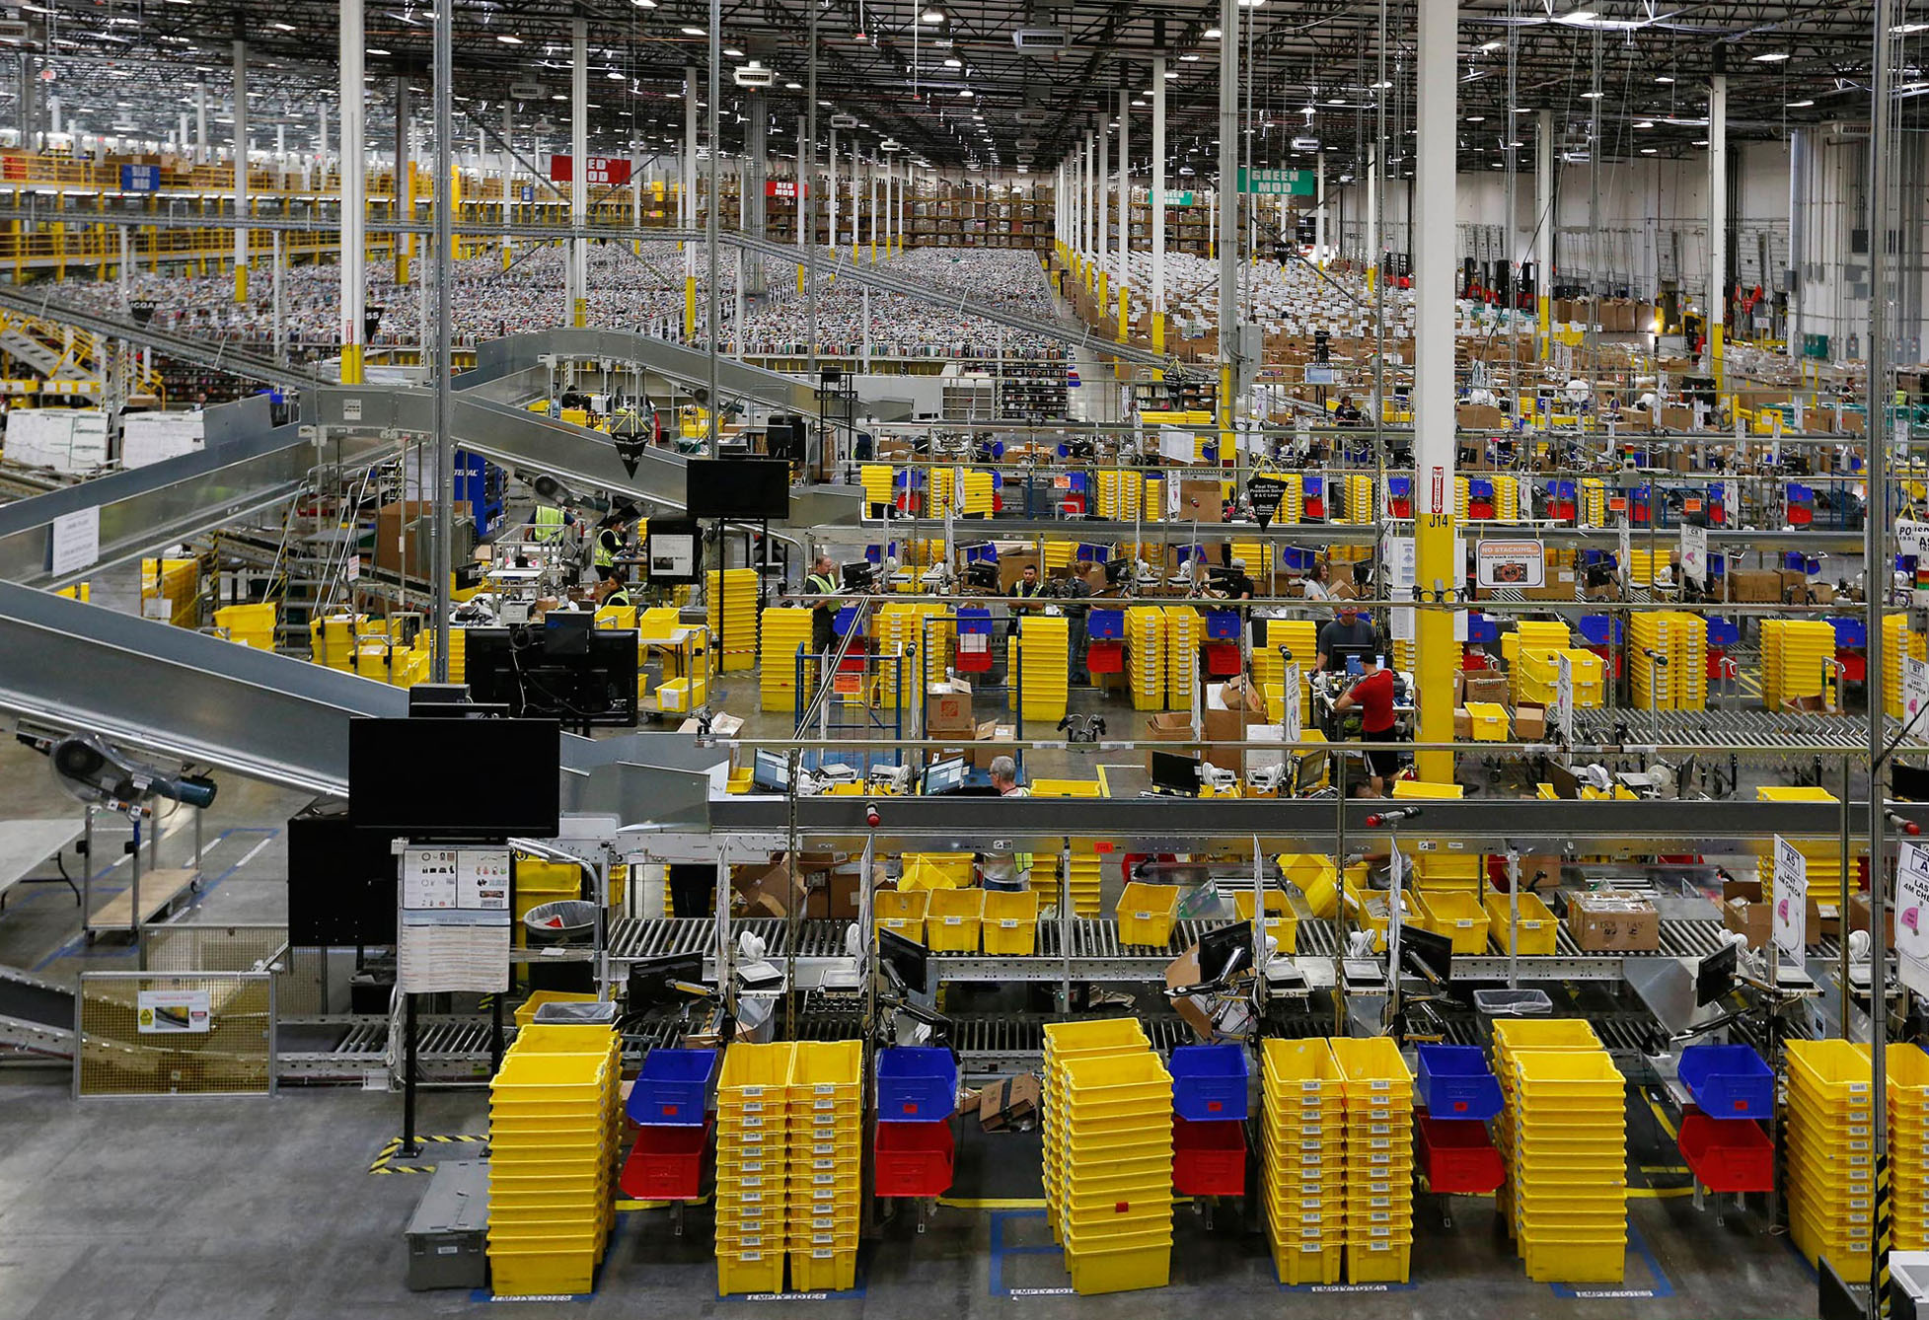
Amazon’s machine learning innovation at scale
4,000 products per minute sold on Amazon.com
1.6M packages every day
Billions of Alexa interactions each week
First Prime Air Delivery on Dec. 7, 2016
Notes:
Amazon has been applying ML in areas such as personalization and supply chain for more than 20 years. ML is an integral part of Amazon.
We’ve improved that original personalization model significantly over time and moved it to other products such as Amazon Prime.
We use ML throughout our fulfillment process including developing a forecast system that can predict the appropriate amount of demand for each product we sell worldwide in order to deliver on our customer expectation on convenience, cost, and delivery speed.
We’ve developed natural language processing technology to give consumers an entirely new way to interact with technology through Alexa.
We’re also developed ground breaking technology with autonomous flight via Prime Air Drones and using robotics in our fulfillment center to get packages to consumers faster.
This was a big culture change for us, but it’s something every organization can do.

Slide 7
Why AWS for ML?
BROADEST AND DEEPEST SET OF AI AND ML SERVICES
ACCELERATE YOUR ADOPTION OF ML
BUILT ON THE MOST COMPREHENSIVE CLOUD PLATFORM
250 new features and services launched this last year for everyone from ML scientists to application developers
Amazon SageMaker creates efficiencies and lowers costs
Acceleration programs and trainings
The strongest set of compute, storage, security, database, and analytics capabilities to build upon
Gartner Vendor Rating (TBD)
Notes:
First, we provide the broadest and deepest set machine learning and AI services for your business:
AWS is unmatched in the breadth and depth of capability we offer to customers.
We launched over 250 new features and services in the last year
And our pace is only accelerating; developers will love waking up virtually every day with new capabilities at their finger-tips.
Second, we can accelerate the adoption of machine learning:
Amazon SageMaker makes it much easier for everyday developers and scientists to embrace machine learning.
Before SageMaker, doing ML was just too hard for most customers. By making ML easier, at low cost, customers can make better use of their data – which is both valuable and differentiating.
Models that previously took customers months and extensive specialized expertize can now be built in weeks or even days.
AWS has also invested in acceleration programs including the ML Solutions Lab and education and training programs like AWS DeepRacer and AWS ML Embark to help your organization more readily adopt ML.
Third, you get the confidence of building on AWS, the most comprehensive cloud platform optimized for machine learning:
That’s why today If you look at the amount of TensorFlow that runs in the cloud, 85 percent of the TensorFlow in the cloud runs on AWS.
We have a team that does nothing but work on optimizing TensorFlow performance on AWS. And they have done a lot of innovation.
Finally, you need the right highly secure, highly reliable, fully featured data store with the right access control, the right security, the broadest set of analytics, and really robust offerings -- at all three layers of the machine learning stack, which we believe that most companies with modern technology capabilities in the future will clearly operate at all three layers of that stack. That's what machine learning is and what's needed, and nobody has that set of capabilities collectively like AWS, which is why twice as many companies are using AWS for machine learning as anybody else.
Supporting data point:
Amazon EC2 Inf1 instances are built from the ground up to support machine learning inference applications. Inf1 instances feature up to 16 AWS Inferentia chips, high-performance machine learning inference chips designed and built by AWS. In addition, we’ve coupled the Inferentia chips with the latest custom 2nd generation Intel® Xeon® Scalable processors and up to 100 Gbps networking to enable high throughput inference. This powerful configuration enables Inf1 instances to deliver up to 3x higher throughput and up to 40% lower cost per inference than Amazon EC2 G4 instances, which were already the lowest cost instance for machine learning inference available in the cloud. Using Inf1 instances, customers can run large scale machine learning inference applications like image recognition, speech recognition, natural language processing, personalization, and fraud detection, at the lowest cost in the cloud.

Slide 8












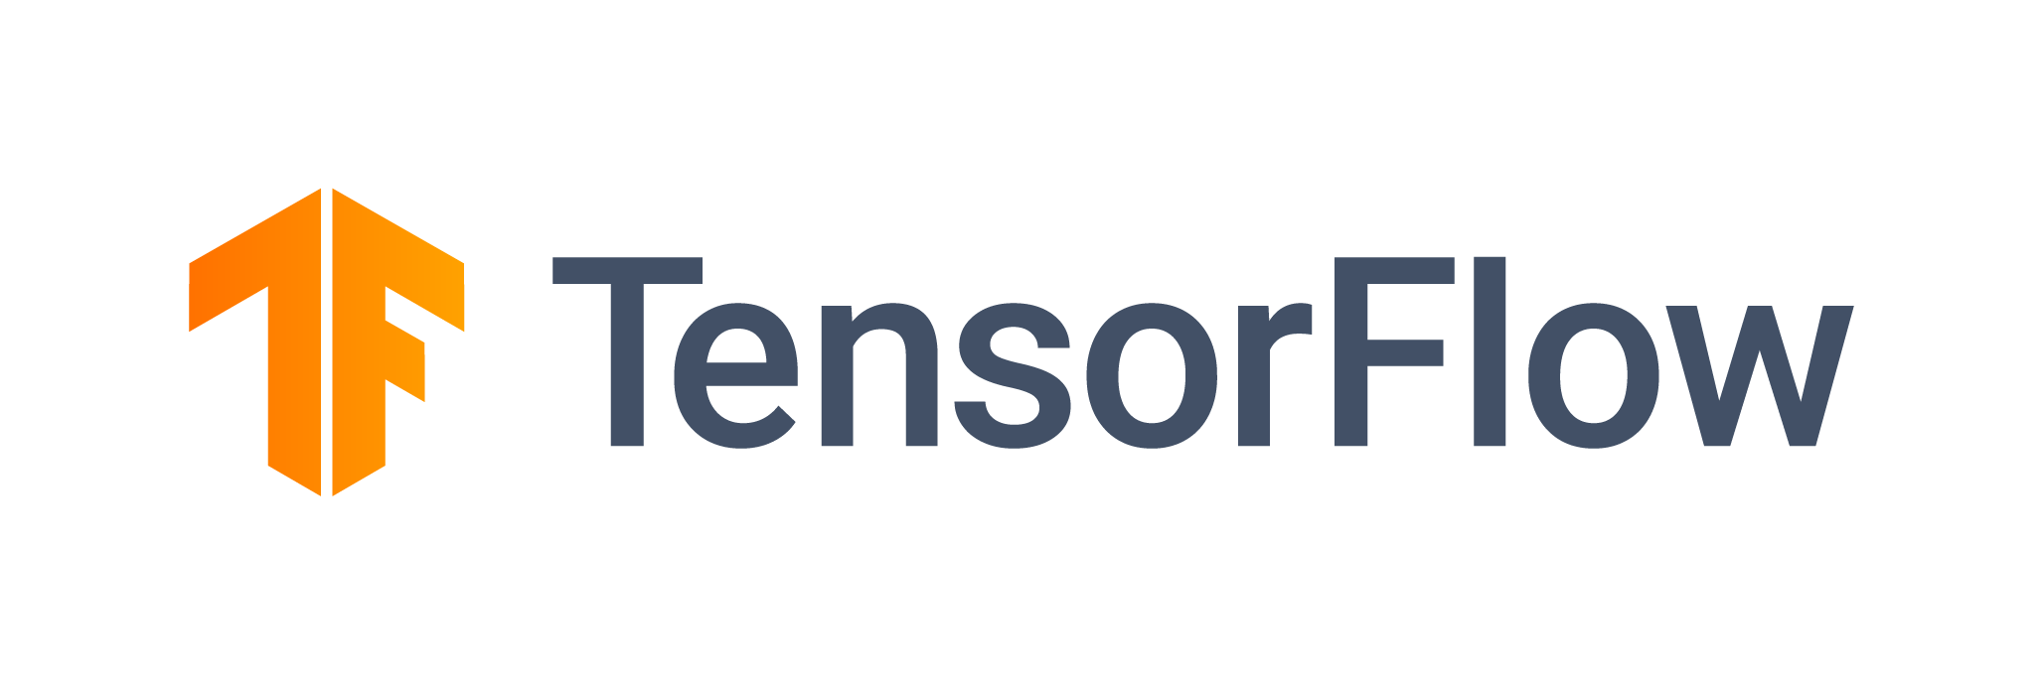






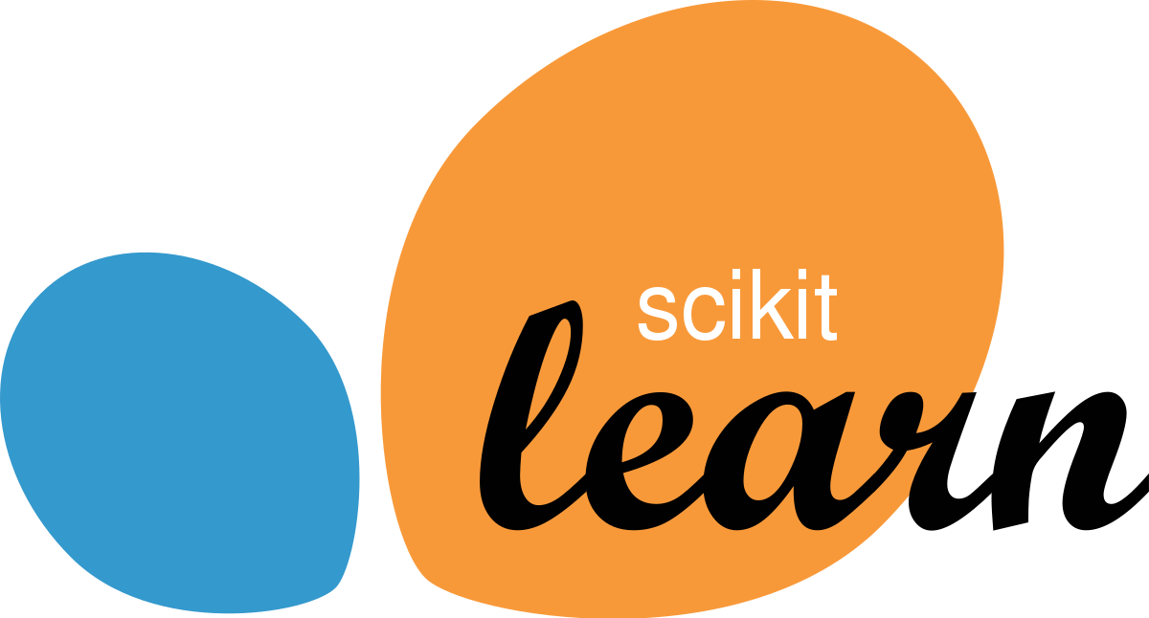

The AWS ML Stack Broadest and most complete set of machine learning capabilities
AI SERVICES
HEALTH AI
INDUSTRIAL AI
ANOMALY DETECTION
CODE AND DEVOPS
NEW
Amazon HealthLake
Amazon Transcribe Medical
Amazon Comprehend Medical
NEW
AWS Panorama + Appliance
NEW
Amazon Monitron
NEW
Amazon Lookout for Equipment
NEW
Amazon Lookout for Vision
NEW
Amazon Lookout for Metrics
NEW
Amazon DevOps Guru
Amazon CodeGuru
 | VISION | SPEECH | TEXT | SEARCH | CHATBOTS | PERSONALIZATION | FORECASTING | FRAUD | CONTACT CENTERS
Amazon Rekognition
Amazon Polly
Amazon Transcribe
+Medical
Amazon Comprehend
+Medical
Amazon Translate
Amazon Textract
Amazon Kendra
Amazon Lex
Amazon Personalize
Amazon Forecast
Contact Lens
Amazon Fraud Detector
Voice ID
For Amazon Connect
ML SERVICES
SAGEMAKER STUDIO IDE
Label data | NEW Aggregate & prepare data | NEW Store & share features | Auto ML | Spark/R | NEW Detect bias | Visualize in notebooks | Pick algorithm | Train models | Tune parameters | NEW Debug & profile | Deploy in production | Manage & monitor | NEW CI/CD | Human review
Amazon SageMaker
NEW: SageMaker JumpStart
NEW: Model management for edge devices
FRAMEWORKS & INFRASTRUCTURE
Deep Learning AMIs & Containers | GPUs & CPUs | Elastic Inference | Trainium | Inferentia | FPGA
DeepGraphLibrary
Notes:
We’re innovating on behalf of our customers to deliver the broadest and deepest set of machine learning capabilities for builders of all levels of expertise. At each layer of the stack, we’re investing in removing the undifferentiated heavy lifting so your teams can move faster. These services are applicable across a broad spectrum of companies, but we’ve also heard from customers that they want specific solutions that are purpose-built for their industries so we are investing in industrials and healthcare.
At the top layer are our AI Services, which allow developers to easily add intelligence to any application without needing ML skills. The pre-trained models provide ready-made intelligence for your applications and workflows to help you do things like personalize the customer experience, forecast business metrics, translate conversations, extract meaning from documents and more. At the middle layer is Amazon SageMaker, which provides every developer and data scientist with the ability to build, train, and deploy machine learning models at scale. It removes the complexity from each step of the machine learning workflow so you can more easily deploy your machine learning use cases, anything from predictive maintenance to computer vision to predicting customer behaviors. Customer achieve up to 10 times improvement in data scientists’ productivity with Amazon SageMaker. And at the bottom layer, expert practitioners can develop on the framework of their choice as a managed experience in Amazon SageMaker or use the AWS Deep Learning AMIs (Amazon machine images), which are fully configured with the latest versions of the most popular deep learning frameworks and tools.

Slide 9














































































































































Machine learning on AWS is happening in companies of every size and industry
Over one hundred thousand customers have chosen AWS for their ML workloads
Notes:
This approach resonates with our customers
More ML happens on AWS than anywhere else. From the largest enterprise through to the hottest startups, AWS has over twice the number of machine learning based public references than any other provider.
Companies are working with us to build solutions that are core to their business.

Slide 10
Getting Started: Common Machine Learning use cases Solve real-world problems with Machine Learning
Improve employee productivity by quickly and easily finding accurate information
Make personalized recommendations to increase customer engagement
Add intelligence to your contact center to improve service and reduce cost
Make faster decisions by automatically extracting and analyzing data from documents
Analyze rich media assets to increase value and create new insights
Make it easy to identify fraudulent online activities
Forecast key demand metrics faster and more accurately to meet customer demand and reduce waste
Notes:
There are common use cases where we have seen our customers be successfully across industries.

Slide 11
AI Services: Easily add intelligence to application
AI SERVICES
HEALTH AI
INDUSTRIAL AI
ANOMALY DETECTION
CODE AND DEVOPS
NEW
Amazon HealthLake
Amazon Transcribe Medical
Amazon Comprehend Medical
NEW
AWS Panorama + Appliance
NEW
Amazon Monitron
NEW
Amazon Lookout for Equipment
NEW
Amazon Lookout for Vision
NEW
Amazon Lookout for Metrics
NEW
Amazon DevOps Guru
Amazon CodeGuru
 | VISION | SPEECH | TEXT | SEARCH | CHATBOTS | PERSONALIZATION | FORECASTING | FRAUD | CONTACT CENTERS
Amazon Rekognition
Amazon Polly
Amazon Transcribe
+Medical
Amazon Comprehend
+Medical
Amazon Translate
Amazon Textract
Amazon Kendra
Amazon Lex
Amazon Personalize
Amazon Forecast
Contact Lens
Amazon Fraud Detector
Voice ID
For Amazon Connect
Notes:
We serve developers and companies who want to add solution-oriented intelligence to their applications through an API call rather than developing and training their own models. And we have a lot of services in this area to address your needs.
Industrial AI services are designed to help our customers in manufacturing, agriculture, energy, or other heavy industries. Amazon HealthLake is specifically made for our health care and life sciences customers.
Vision (Rek Image and video) “tell me what’s in this image,” “which celebrities are in this image,” and, “is this image safe for work?”
Speech – (Polly, Transcribe) – If you want to turn text into speech we have Polly, and if you want to transcribe audio we have Transcribe
Text (translate, comprehend, textract) – If you want to translate text to different languages we have translate, and if you want to understand what’s being said in those translated corpuses of text you have Comprehend, if you want to extract text from documents using OCR++, you have Textract.
Then you have the things which Amazon is relatively famous for. Alexa and chatbots with Lex, personalization, and forecasting
Amazon Kendra is a new service which reinvents enterprise search with machine learning.
Amazon Fraud Detector, a new fraud management service for detecting online identify and payment fraud in real-time. No machine learning experience required.
Amazon CodeGuru, a new machine learning service to automate code reviews and identify your most expensive line of code. Amazon DevOps Guru provides dev/ops engineers an early warning system for operational issues.
Contact Lens for Amazon Connect provides machine learning powered contact center analytics for Amazon Connect.

Slide 12
Amazon SageMaker key benefits
Accelerate ML development
20+ tools covering the entire ML development lifecycle
Boost data scientist productivity
The world’s first integrated development environment (IDE)
The most complete, end-to-end ML service
Reduce cost
Eliminate costs of writing custom integration code with integrated functionality optimized for ML
Notes:
Amazon SageMaker is the most complete end-to-end ML service helping our customer through improved agility, productivity, and cost-effectiveness.
Agility: Accelerate ML development with 20+ purpose-built tools ranging from Amazon SageMaker Data Wrangler for data preparation to SageMaker Pipelines for workflows, covering the entire ML development lifecycle.
Productivity: Boost your productivity using Amazon SageMaker Studio, the first IDE designed specifically for ML that brings everything you need for ML under one unified, visual interface.
Cost-effectiveness: Eliminate costs of writing custom integration code by leveraging tightly integrated Amazon SageMaker capabilities for data preparation, debugging, training, deployment, and model monitoring.

Slide 13
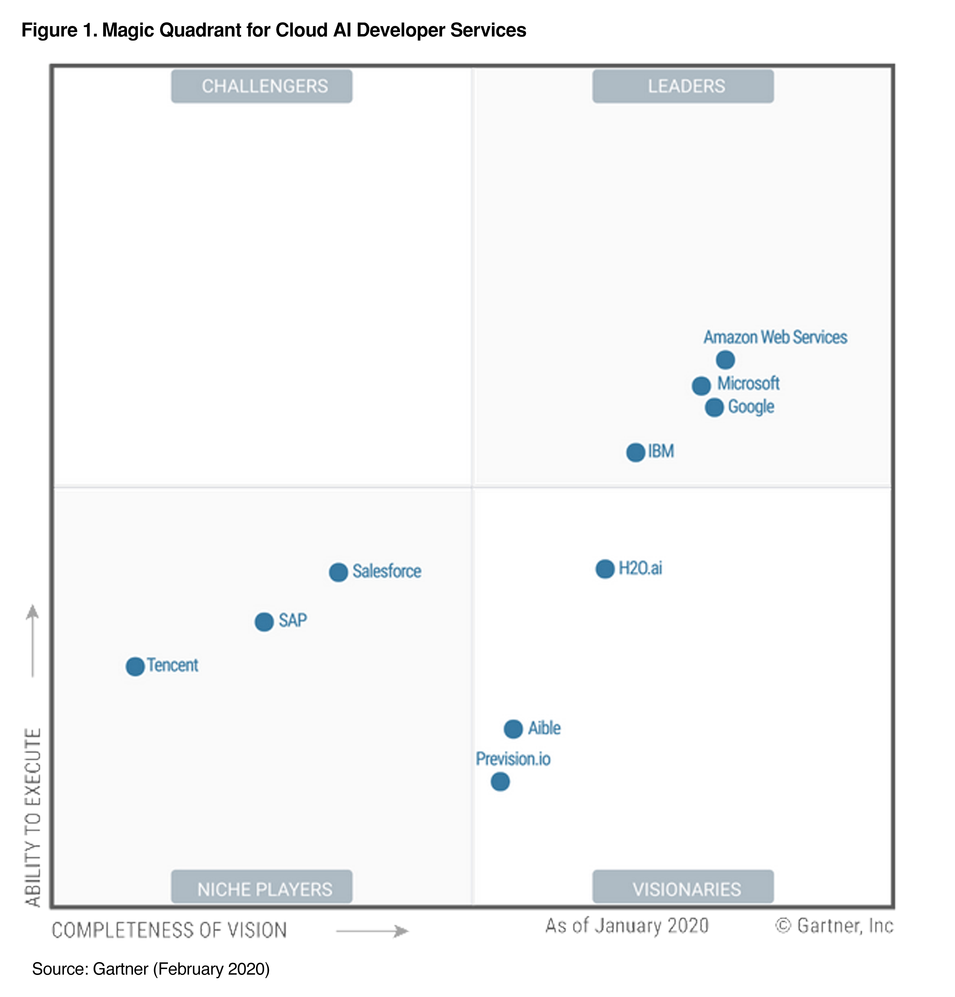
AWS recognized as leader in Gartner Magic Quadrant for cloud AI developer services.
In the Gartner “Solution Scorecard for Amazon SageMaker, July 2020”, SageMaker has an overall score of 84/100, the highest rating among its peer group.
This graphic was published by Gartner, Inc. as part of a larger research document and should be evaluated in the context of the entire document. The Gartner document is available upon request from AWS. Gartner does not endorse any vendor, product or service depicted in its research publications, and does not advise technology users to select only those vendors with the highest ratings or other designation. Gartner research publications consist of the opinions of Gartner's research organization and should not be construed as statements of fact. Gartner disclaims all warranties, expressed or implied, with respect to this research, including any warranties of merchantability or fitness for a particular purpose
Notes:
Our breadth and depth of solutions has been recognized by Gartner.
AWS was named leader in the first Gartner Magic Quadrant for Cloud AI based on Ability to Execute and Completeness of Vision.
In the Gartner “Solution Scorecard for Amazon SageMaker, July 2020”, SageMaker has an overall score of 84/100, the highest rating among its peer group.
According to Gartner, SageMaker met 87% of Gartner’s required criteria, 73% of preferred, and 85% of optional.

Slide 14
Getting started: Next Steps
Training
Proof of Concept
Production
AWS ML Embark Program
AWS Deep Devices
Amazon Machine Learning Solutions Lab
Amazon ProServ
Amazon Partner Network
Notes:
AWS has a number of trainings and acceleration programs to help you get started on your journey.
We offer in-person trainings for both technical and business stakeholders through our AWS ML Embark Program as well as a full free online training and certification program for your developers. In addition to this, our portfolio of Deep Devices-AWS DeepRacer, DeepComposer, and DeepLens, were designed to get developers hands-on with a fun and engaging way to learn ML.
To develop a proof of concept, we can conduct workshops to help you identify the best use cases for your business and work hand and hand with your team to develop a proof of concept through the ML Solutions Lab.
Lastly, if you need help taking a solution to production, we have a Professional Services team as well as ML partners who can do end to end development and take your machine learning application to production.

Slide 15
ML.aws
Thank you!

Slide 16
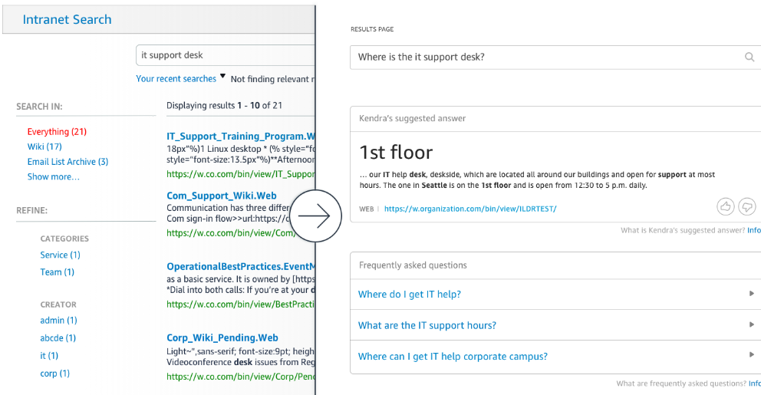





Increase employee productivity by quickly and easily finding accurate information
“We introduce over 1200 new products every year. When our material scientists lead new research, they need access to information from prior relevant research—information that’s buried in the many patents we hold in our huge knowledge base. Finding the right information is often exhausting (but not exhaustive) and time-consuming.”
DAVID FRAZEE
Technical Director
Corporate Research Systems Lab
Amazon Kendra
Ask natural language questions, get immediate answers
Bring all of your data together in a few clicks
Constantly improving search results

Slide 17
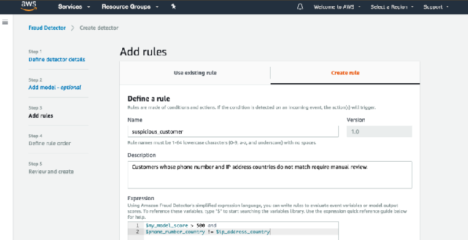


Make it easy to identify fraudulent online activities
“We’re excited about the introduction of Fraud Detector because it means we can more easily use advanced machine learning techniques to accurately detect fraudulent reservations. Protecting our ‘front door’ from potential harm enables us to focus on making the vacation rental experience seamless and worry-free.”
ERIC BREON
Founder and CEO
Amazon Fraud Detector
Build high quality fraud detection ML models faster
Stop bad actors at the door
Built-in online fraud expertise
Give fraud teams more control

Slide 18
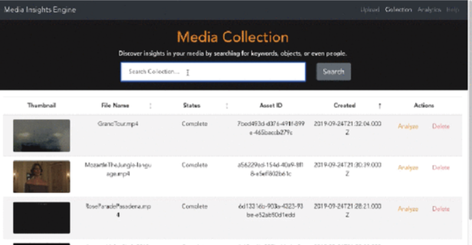




Analyze your rich media assets to increase value and create new insights from the content
“C-SPAN uses Amazon Rekognition to automatically index video news footage for search. With Rekognition, C-SPAN reduced indexing time per video from 1 hour to 20 minutes and uploaded 97,000 images in under 2 hours.”
IAN CLOUTIER
Technical Manager
Drive monetization through contextual ad placement and more
Reduce costs and improve productivity by automating key functions of the media supply chain
Avoid risk of displaying inappropriate content as well as creating branding issues
Amazon Translate
Amazon Rekognition
Amazon Transcribe
Amazon Comprehend

Slide 19
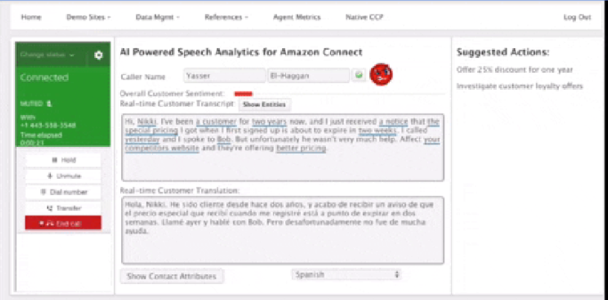






Add intelligence to your contact center to improve service and reduce cost
“We are now trialing the use of AI to gather information about the caller’s needs upfront. The operator sees that information on-screen and can offer a resolution right away. Operators enjoy being more helpful to callers and appreciate less repetition on the job”
CHRIS SUTER
Lead Cloud Architect
Reduce costs
Decrease time to resolution (TTR)
Reduce call wait times
Increase customer satisfaction
Improve employee satisfaction
Amazon Translate
Amazon Transcribe
Amazon Comprehend
Amazon Lex
Amazon Polly

Slide 20












Make personalized recommendations to increase customer engagement
“With the implementation of Amazon Personalize we are seeing, email CTR is up 67% over our control messaging. Rev/M Sends is up 49%, and because the content is even more relevant, our Opt out Rate has dropped 36%. But where the rubber hits the road for me is on revenue. Test emails have shown a 12.5% increase in revenue versus the control. It is clear that the AWS has given us another ‘arrow in our quiver’. My only regret is this capability didn’t exist two years ago when we started this journey.”
KRISTINA SMITH
Director Global Digital Marketing
Create high-quality recommendations
Own the moment with real-time recommendations
Personalize every touchpoint along the user journey
Deliver personalization within days, not months
Amazon Personalize

Slide 21
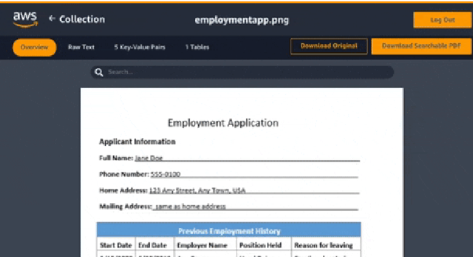











Make faster decisions by automatically extracting and analyzing data from documents
“Amazon Comprehend and Amazon Transcribe services allow VidMob to build high-quality machine learning text analysis into our Agile Creative Suite, enabling us to help brand clients understand content performance in ways never before possible. We are able to transcribe text from video content, and quickly analyze it using Comprehend, allowing us to surface actionable insights to both our creator community and our clients, giving them a strategic edge in the market.”
ALEX COLLMER
Founder and Chief Executive Officer
Get better answers from your text
Organize documents by topics
No code or templates to maintain
Lower document processing costs
Amazon Comprehend
+Medical
Amazon Textract

Slide 22
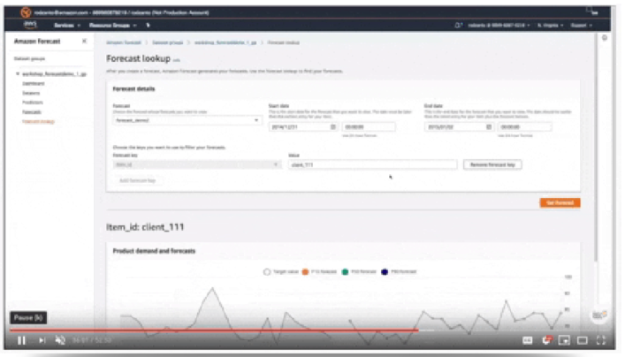


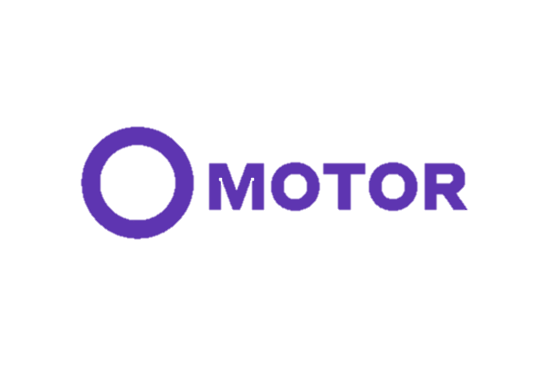






Forecast key demand metrics faster and more accurately to meet customer demand and reduce waste
“At CasaOne, we make sure our customers get access to their furniture in a few business days. In order to better predict how many couches CasaOne customers might rent in the Bay Area or how many coffee tables customers might rent in NY, we leverage the capabilities of Amazon Forecast. With Amazon Forecast, our sales prediction accuracy has improved by 20% compared to our existing forecasting algorithm. This means we can stock the right products and save on purchase costs worth a few thousand dollars. Improved product selection will also lead to enhanced customer experience in the long run."
MADHUSUDAN KAGWAD
Co-founder and Head of Products
Amazon Forecast
50% more accurate forecasts with machine learning
Reduce forecasting time from months to hours
Create virtually any time series forecast
Secure your business data and peace of mind

Slide 23
SPEAKER GUIDANCE—REMOVE THIS SLIDE
200-Level Introduction to AWS Machine Learning
The following set of slides are meant for an introduction to AWS’s ML approach and technology with deeper dives on our technology.
Use these slides in more detailed conversations with customers about AWS’s ML capabilities. You may also pull slides to supplement the content in the 100-level deck.

Slide 24
AWS Machine Learning
Overview
Péter Molnár, February 2021
Notes:
First call deck for introduction to Amazon Machine Learning

Slide 25
Technology
Bringing ML into your digital transformation requires a new “stack” that makes it easier to put ML to work
Notes:
On the technology side, ML should increasingly be integrated into just about every aspect of your business.
To do so, requires a new stack that is tailored to the unique needs of your business.

Slide 26
The AWS ML Stack Broadest and most complete set of machine learning capabilities
AI SERVICES
HEALTH AI
INDUSTRIAL AI
ANOMALY DETECTION
CODE AND DEVOPS
NEW
Amazon HealthLake
Amazon Transcribe Medical
Amazon Comprehend Medical
NEW
AWS Panorama + Appliance
NEW
Amazon Monitron
NEW
Amazon Lookout for Equipment
NEW
Amazon Lookout for Vision
NEW
Amazon Lookout for Metrics
NEW
Amazon DevOps Guru
Amazon CodeGuru
 | VISION | SPEECH | TEXT | SEARCH | CHATBOTS | PERSONALIZATION | FORECASTING | FRAUD | CONTACT CENTERS
Amazon Rekognition
Amazon Polly
Amazon Transcribe
+Medical
Amazon Comprehend
+Medical
Amazon Translate
Amazon Textract
Amazon Kendra
Amazon Lex
Amazon Personalize
Amazon Forecast
Contact Lens
Amazon Fraud Detector
Voice ID
For Amazon Connect
ML SERVICES
SAGEMAKER STUDIO IDE
Label data | NEW Aggregate & prepare data | NEW Store & share features | Auto ML | Spark/R | NEW Detect bias | Visualize in notebooks | Pick algorithm | Train models | Tune parameters | NEW Debug & profile | Deploy in production | Manage & monitor | NEW CI/CD | Human review
Amazon SageMaker
NEW: SageMaker JumpStart
NEW: Model management for edge devices
FRAMEWORKS & INFRASTRUCTURE
Deep Learning AMIs & Containers | GPUs & CPUs | Elastic Inference | Trainium | Inferentia | FPGA
DeepGraphLibrary
Notes:
We’re innovating on behalf of our customers to deliver the broadest and deepest set of machine learning capabilities for builders of all levels of expertise. At each layer of the stack, we’re investing in removing the undifferentiated heavy lifting so your teams can move faster. We also now have purpose-built solutions for industries, such as industrials and healthcare.
Let’s take a walk through this the three layers.

Slide 27
The AWS ML Stack Broadest and most complete set of machine learning capabilities
AI SERVICES
HEALTH AI
INDUSTRIAL AI
ANOMALY DETECTION
CODE AND DEVOPS
NEW
Amazon HealthLake
Amazon Transcribe Medical
Amazon Comprehend Medical
NEW
AWS Panorama + Appliance
NEW
Amazon Monitron
NEW
Amazon Lookout for Equipment
NEW
Amazon Lookout for Vision
NEW
Amazon Lookout for Metrics
NEW
Amazon DevOps Guru
Amazon CodeGuru
 | VISION | SPEECH | TEXT | SEARCH | CHATBOTS | PERSONALIZATION | FORECASTING | FRAUD | CONTACT CENTERS
Amazon Rekognition
Amazon Polly
Amazon Transcribe
+Medical
Amazon Comprehend
+Medical
Amazon Translate
Amazon Textract
Amazon Kendra
Amazon Lex
Amazon Personalize
Amazon Forecast
Contact Lens
Amazon Fraud Detector
Voice ID
For Amazon Connect
ML SERVICES
SAGEMAKER STUDIO IDE
Label data | NEW Aggregate & prepare data | NEW Store & share features | Auto ML | Spark/R | NEW Detect bias | Visualize in notebooks | Pick algorithm | Train models | Tune parameters | NEW Debug & profile | Deploy in production | Manage & monitor | NEW CI/CD | Human review
Amazon SageMaker
NEW: SageMaker JumpStart
NEW: Model management for edge devices
FRAMEWORKS & INFRASTRUCTURE
Deep Learning AMIs & Containers | GPUs & CPUs | Elastic Inference | Trainium | Inferentia | FPGA
DeepGraphLibrary
Notes:
We think about ML at a macro level as having 3 layers of the stack…
At the bottom layer is the frameworks, interfaces, and infrastructure for expert ML practitioners
At the frameworks layer, there are three frameworks that are predominantly used: TensorFlow, PyTorch, and MXNet.
Today, 92% of cloud-based TensorFlow and 91% of cloud-based PyTorch runs on AWS.
New algorithms are being developed all the time in different frameworks that people want to borrow from, or run in that framework – instead of having to port it themselves to a different framework. So we have dedicated teams for all of the major frameworks so customers have the right tool for the right job.
AWS provides the broadest and deepest portfolio of ML infrastructure services with a choice of processors and accelerators to meet your unique performance and budget needs. Amazon EC2 P4d instances provide the highest performance for ML training in the cloud with the latest NVIDIA A100 Tensor Core GPUs coupled with first in the cloud 400 Gbps instance networking. P4d instances are deployed in hyper scale clusters, called EC2 UltraClusters, offering supercomputer-class performance for the most complex ML training jobs. For inference, Amazon EC2 Inf1 instances, powered by AWS Inferentia chips, provide high performance and lowest cost inference in the cloud.

Slide 28
Inf1 instances are built from the ground up by AWS to provide high performance, cost-effective inference
CUSTOM BUILT FOR ML INFERENCE
AWS Nitro
AWS Inferentia
https://aws.amazon.com/ec2/instance-types/inf1
AWS Custom 2nd Gen Intel Xeon Scalable Processors
100Gbps Networking
HIGH PERFORMANCE
LOW COST
Notes:
Inf1 instances are based on AWS Inferentia chips, which are custom built by AWS for machine learning inference. The Inferentia chips are coupled with the latest custom 2nd generation Intel® Xeon®Scalable processors and up to 100 Gbps networking to enable high throughput inference. These instances are based on the AWS Nitro System, which is a combination of dedicated hardware and lightweight hypervisor that enables faster innovation and enhanced security in Amazon EC2.
The EC2 Inf1 instances feature AWS Neuron, an SDK that natively integrates into popular machine learning frameworks such as Tensorflow, PyTorch, and MXNet, and optimizes performance for the Inferentia chips. The Neuron SDK is integrated into SageMaker Neo to make it easy for developers to deploy their ML models to Inf1 instances.
With this combination, Inf1 instances provide high performance and lowest cost inference in the cloud, making it economically feasible to deploy complex and large scale machine learning inference applications such as image recognition, speech recognition, natural language processing, and fraud detection

Slide 29
The AWS ML Stack Broadest and most complete set of machine learning capabilities
AI SERVICES
HEALTHCARE AI
INDUSTRIAL AI
ANOMALY DETECTION
CODE AND DEVOPS
NEW
Amazon HealthLake
Amazon Transcribe for Medical
Amazon Comprehend for Medical
NEW
AWS Panorama + Appliance
NEW
Amazon Monitron
NEW
Amazon Lookout for Equipment
NEW
Amazon Lookout for Vision
NEW
Amazon Lookout for Metrics
NEW
Amazon DevOps Guru
Amazon CodeGuru
 | VISION | SPEECH | TEXT | SEARCH | CHATBOTS | PERSONALIZATION | FORECASTING | FRAUD | CONTACT CENTERS
Amazon Rekognition
Amazon Polly
Amazon Transcribe
+Medical
Amazon Comprehend
+Medical
Amazon Translate
Amazon Textract
Amazon Kendra
Amazon Lex
Amazon Personalize
Amazon Forecast
Contact Lens
Amazon Fraud Detector
Voice ID
For Amazon Connect
ML SERVICES
SAGEMAKER STUDIO IDE
Label data | Aggregate & prepare data | Store & share features | Auto ML | Spark/R | Detect bias | Visualize in notebooks | Pick algorithm | Train models | Tune parameters | Debug & profile | Deploy in production | Manage & monitor | CI/CD | Human review
Ground Truth | NEW Data Wrangler | NEW Feature store | Autopilot | Processing | NEW Clarify | Studio Notebooks | Built-in or Bring-your-own | NEW Experiments Spot Training Distributed Training | Automatic Model Tuning | Debugger | NEW Model Hosting Multi-model Endpoints | Model Monitor | NEW Pipelines | Augmented AI
Amazon SageMaker
AMAZON SAGEMAKER JUMPSTART
NEW: AMAZON SAGEMAKER EDGE MANAGER
FRAMEWORKS & INFRASTRUCTURE
Deep Learning AMIs & Containers | GPUs & CPUs | Elastic Inference | Trainium | Inferentia | FPGA
DeepGraphLibrary
Notes:
There’s not that many expert ML practitioners, so if you want ML to be pervasive, you have to make it easier for everyday developers and data scientists to build, train, and tune ML models. And that’s what the middle layer of the stack is for.

Slide 30
Amazon SageMaker: Built to make ML more accessible
Label data
Collect and prepare data
Store features
Check data
Visualize in notebooks
Pick algorithm
Train models
Tune parameters
Deploy in production
Manage and monitor
CI/CD
SageMaker Studio IDE
Notes:
We built Amazon SageMaker from the ground up to provide every developer and data scientist with the ability to build, train, and deploy ML models quickly and at lower cost by providing the tools required for every step of the ML development lifecycle in one integrated, fully managed service. In fact, we have launched 50+ capabilities in the past year alone, all aimed at making this process easier for our customers.
And last year we launched Amazon SageMaker Studio to bring this all together in a single pane of glass so that you get access to all your tools in one place.

Slide 31
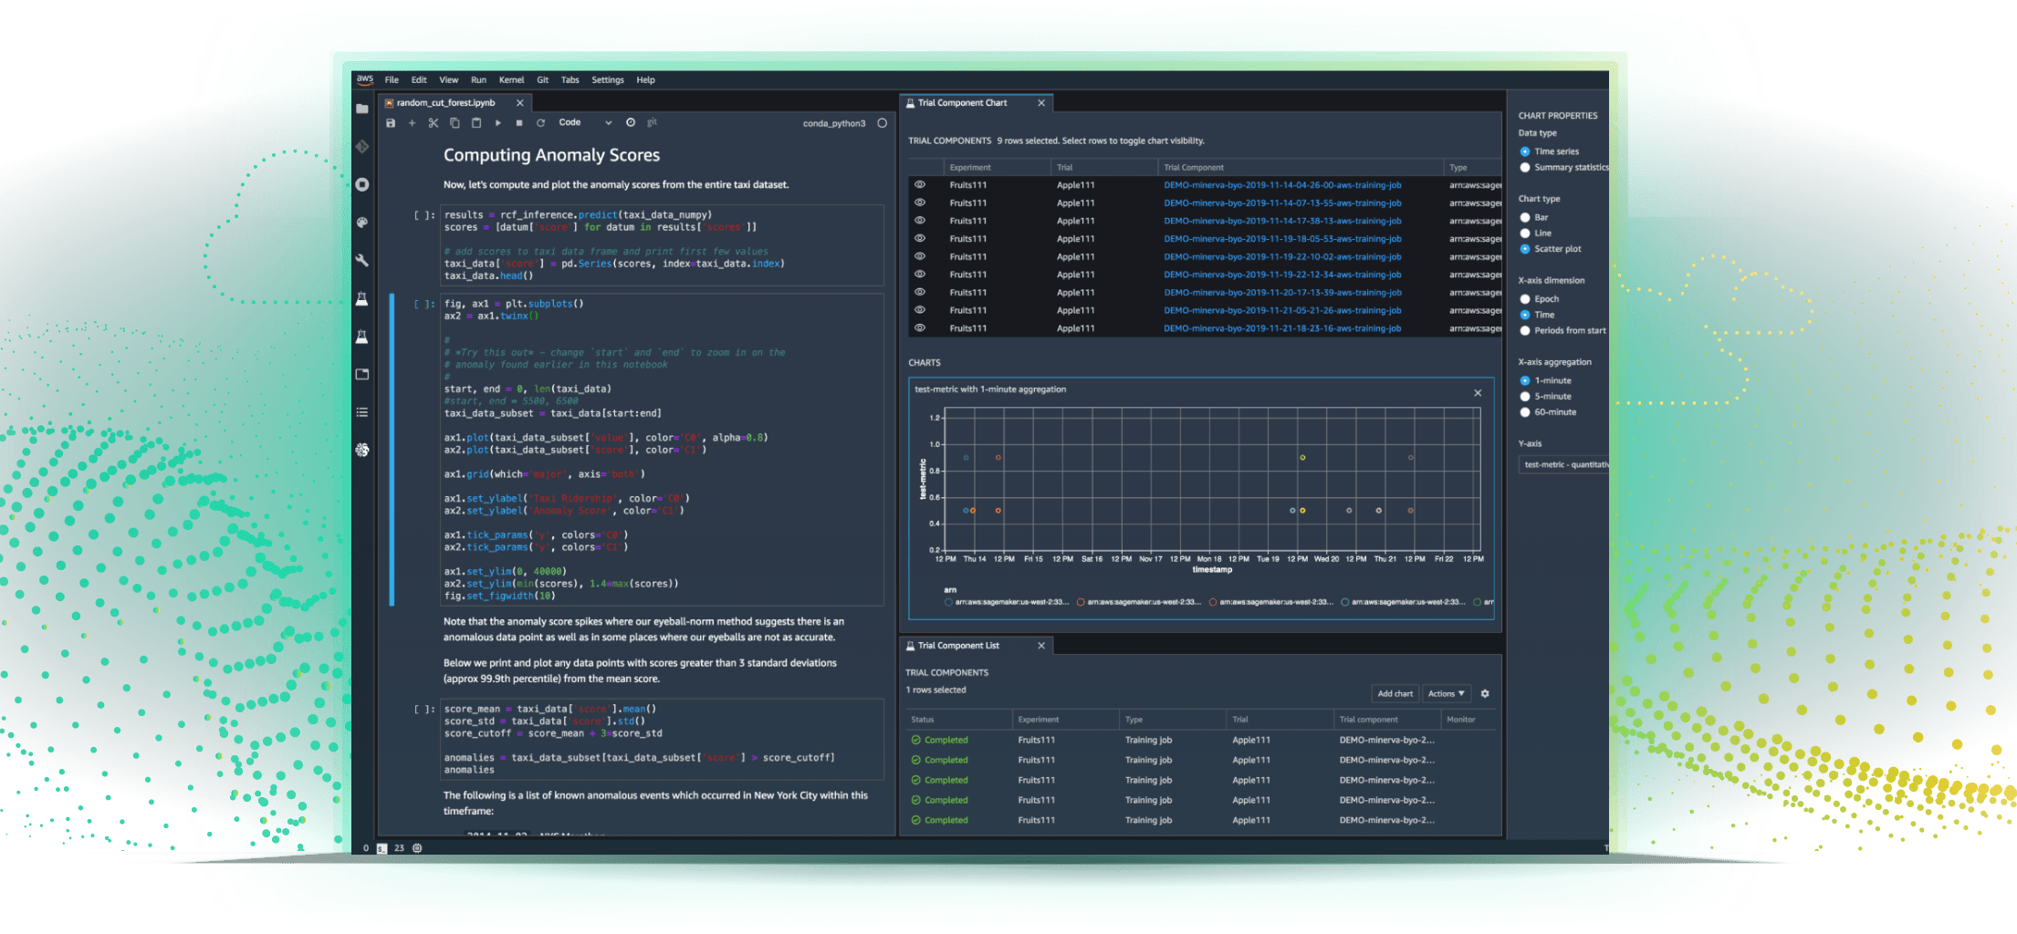
Amazon SageMaker
Most complete, end-to-end ML service
Integrated Workbench
IDE designed specifically for ML, data preparation, experiment management, and pipelines
Managed Infrastructure
Designed for ultra low latency and high throughput; automatic scaling, and distributed training
Managed Tooling
Purpose-built from the ground up to work together incl. Autopilot, collaboration, notebooks, experiments, debugger, and model monitor
https://aws.amazon.com/sagemaker
Notes:
Amazon SageMaker is the most complete, end-to-end service for machine learning. It is a managed service for data scientists and ML operations teams that helps remove the undifferentiated heavy lifting associated with machine learning, so that you in turn can have more time, resources and energy to focus on your business. SageMaker has a lot of features and a full workbench of capabilities, so I’m going to talk you through 4 main pillars that describe what SageMaker is, and how it gets used.
First off, SageMaker provides users with an integrated workbench of tools brought together in one place through SageMaker Studio. Users can launch Jupyter Notebooks and Jupyter Lab environments instantly through SageMaker Studio. SageMaker also provides complete experiment management, data preparation, and pipeline automation and orchestration to help make data scientists more productive.
Now, if you have used a Jupyter Notebook before, you know that it needs a computing environment to run on. SageMaker provides fully managed servers in the cloud to make this easy for data scientists and developers. But even beyond notebooks, SageMaker provides other managed infrastructure capabilities as well. From distributed training jobs, data processing jobs, and even model hosting, SageMaker takes care of all of the scaling, patching, high availability, etc. associated with building, training and hosting models.
There are tools within SageMaker that help make data scientists more productive. What you’ll see is that this integrated workbench, sitting on managed infrastructure, is also enriched by a huge ecosystem of tools, all purpose-built for ML and designed from the ground up to work together.

Slide 32
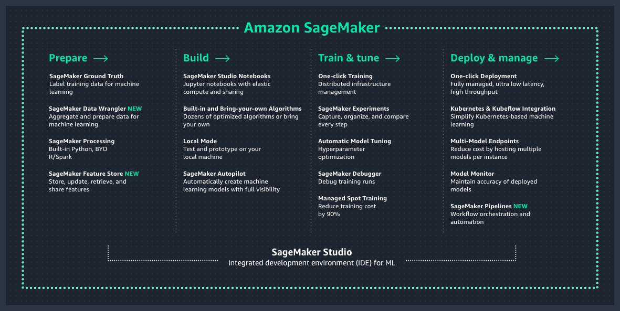
Amazon SageMaker overview
Notes:
As mentioned, SageMaker is a service with a lot of different features and capabilities in it. We typically talk about those capabilities as falling into four categories: Data preparation, the model build phase, training and tuning, and deployment and management (or hosting).
These four categories really address the needs that ML builders have when dealing with each stage of a model’s lifecycle.

Slide 33
Amazon SageMaker key benefits
Accelerate ML development
20+ tools covering the entire ML development lifecycle
Boost data scientist productivity
The world’s first integrated development environment (IDE)
The most complete, end-to-end ML service
Reduce cost
Eliminate costs of writing custom integration code with integrated functionality optimized for ML
Notes:
Amazon SageMaker is the most complete end-to-end ML service helping our customer through improved agility, productivity, and cost-effectiveness.
Agility: Accelerate ML development with 20+ purpose-built tools ranging from Amazon SageMaker Data Wrangler for data preparation to SageMaker Pipelines for workflows, covering the entire ML development lifecycle.
Productivity: Boost your productivity using Amazon SageMaker Studio, the first IDE designed specifically for ML that brings everything you need for ML under one unified, visual interface.
Cost-effectiveness: Eliminate costs of writing custom integration code by leveraging tightly integrated Amazon SageMaker capabilities for data preparation, debugging, training, deployment, and model monitoring.

Slide 34
Balancing ML agility with IT governance
ML Builders
Cloud IT and DevOps
Focus on unique business value
Self-service access
Experiment fast
Respond quickly to change
Security
Compliance
Operations
Spend management
Notes:
While agility is great to build and train models rapidly, it doesn’t do anything for you if you can’t get your models to production reliably, repeatably, and most importantly: securely!
The desire for agile experimentation has to be balanced with proper governance, operational guidelines, and cost controls.
The good news is that this kind of balance between ML agility, and IT governance, can be achieved with SageMaker.

Slide 35
Amazon SageMaker
Security
Security features to help you meet strict security requirements of ML workloads
Compliance
PCI, HIPAA, SOC 1/2/3, FedRAMP, and ISO 9001/27001/27017/27018
is devops ready
ML workflows
Create automated workflows in minutes to support thousands of models
Scalability
Train complex models with massive datasets
Orchestration
Automatic scheduling and execution of jobs with managed infrastructure
Notes:
Amazon SageMaker provides robust IT Ops features across security, workflows, scalability, and orchestration.

Slide 36

PROBLEM
3+ terabytes data, 1,500+ hours play time per week
Needed a solution for real-time stats
Lean team, no data science expertise
SOLUTION: NEXT GEN STATS
Engaged with ML Solutions Lab
Live data streamed to AWS from RFID tags on players and in game ball
Data processed in 100+ steps in under 1 second
ML models built on Amazon SageMaker make predictions in real time
IMPACT
Launched 20+ stats quickly with limited data science team
Sports announcers get interesting data points to engage fans
Notes:
Company background:
The National Football League (NFL) has 180 million fans worldwide. About 17 million of those trek out to stadiums each season—which means over 90% of NFL fans are catching the games on TV, online, and mobile. That's why NFL games represented 37 of the top 50 highest-rated television broadcasts of 2017.
Challenge:
The NFL has been keeping game statistics since 1920, and has been showing standard stats for the past several decades such as yards passing, yards rushing, catches, tackles, quarterback sacks, and interceptions. But these stats represent only a tiny fraction of the 2 terabytes of data the league collects every week from 1,500+ hours of play time. They saw the potential to use this data to provide new live predictive stats such as the probability of a pass completion. This required a machine learning solution that can analyze vast amounts of data and make predictions in real time.
Solution:
The NFL teamed up with AWS to transform how football is analyzed, played, coached, and experienced by fans, broadcasters, coaches, and teams. Through RFID tags attached to the players’ shoulder pads and embedded in the game ball, the NFL collects large volumes of tracking data like location, speed, acceleration, and distance traveled, charting individual movements within inches. In 2016, the NFL began working with AWS to leverage their expertise and to accelerate the Next Gen Stats (NGS) program to combine old and new data to provide players and fans with predictive stats about the game in real time. An example stat is the Completion Probability, which is the likelihood of a pass being completed. It’s predicted based on numerous factors, including the receiver’s separation from the nearest defender, the receiver’s location on the field, and the separation of the passer at the time of the throw from the nearest pass rusher.
In partnership with AWS Professional Services, the Next Gen Stats team created and deployed machine learning models using SageMaker. These models leverage inputs from traditional statistics, player tracking data, and player profiles. The models are continuously refined by the Next Gen Stats team to reflect trends and outcomes during any given season. Once deployed, the machine learning models provide real-time inference during games. To obtain real-time insights, data from the stadiums is streamed to AWS. Once in AWS, the data undergoes over a hundred processing steps in under a second.
As a result of this solution, the NFL is able to produce APIs, create on-screen graphics, give sports announcers unique data points to talk about, and expand their media and team tools.
The NFL is also working with AWS machine learning to create the Digital Athlete platform, which will improve player safety, treatment, and ultimately predict and prevent injury. The platform will use a computer simulation model of an NFL player that combines numerous data sources, including NGS data, to help the NFL test different scenarios without risk to athletes. The NFL plans to use machine learning to reduce injuries – leveraging data to understand how head injuries occur, how they can prevent them, and how to design better equipment and rules.
Link: https://blog.aboutamazon.com/amazon-ai/partnering-with-the-nfl-to-transform-player-health-and-safety
Why SageMaker?
The Next Gen Stats team is lean with just a handful of engineers, who are trained mainly in software development, but not as much in data science. SageMaker’s built-in algorithms and Jupyter Notebook instances allowed the small team to build and publish 20+ stats quickly without having to hire teams of data scientists.
NFL business outcomes:
Using SageMaker to build, train and run these predictive models helped reduce the time to get to insights from as much as 12 hours to 30 minutes. These insights help fans understand why some passing plays are more difficult than others and provide more meaningful understanding of the game itself. Additionally, these insights can be used by the NFL and its media partners quickly to enhance broadcasts and online content, as well as educate and engage fans inside the stadium. With SageMaker, the NFL didn’t need to hire teams of data scientists to accomplish all this, and could get up and running right away.
MORE INFO:
https://aws.amazon.com/nextgenstats/

Slide 37
Next Gen Stats solution architecture
NGS Processors
Stadium
Tracking data
Apache Kafka
Data distributors
Stats FTP
Traditional stats
NGS Processors
ML Processors
Websites
SageMaker
NGS API
Club Tools
Entire solution runs on AWS
Amazon SageMaker lets ML models deployed into existing analytics pipelines
Streaming data architecture with Apache Kafka
Notes:
SageMaker provided the team the flexibility to continue to use their existing architecture consisting of open-source tools such as Apache Kafka. With SageMaker, they were able to deploy machine learning models into their existing analytics pipeline without significant changes to the architecture.

Slide 38


PROBLEM
Thomson Reuters wanted to enable ML at scale
Data scientists needed secure access to data, while ensuring compliance with Thomson Reuters enterprise security policies
SOLUTION: SECURE CONTENT WORKSPACES
SCW provides access to data in compliance with internal security standards
Amazon SageMaker, enabled through SCW, provides a fully managed machine learning environment
IMPACT
Secure experimentation at scale in compliance with TR policies
Intelligent + timely solutions for their customers
Notes:
Challenge:
To enable this customer-centric structure, Thomson Reuters began a migration project in 2018 to exit 7-9 strategic data centers, and move their data into AWS. During this time, Thomson Reuter’s data scientists started testing Amazon SageMaker across different business units. Most of these efforts happened in silos, causing technical issues that consumed significant time and resources.
Solution:
In early 2019, Thomson Reuters built an internal platform, Secure Content Workspaces (SCW), to enable data scientists and developers across the company to access data in compliance with the company’s security standards. Using SCW with Amazon SageMaker, they were able to eliminate the need for data scientists to deal with data access permissions, network security, user roles, containers, and other challenges associated with building, training, and managing ML models. This allowed the data scientists to focus on their core competencies of data science and analytics instead of managing infrastructure, networking, and data pipelines.
Why SageMaker?
Since 2018, AWS has been the preferred cloud provider at Thomson Reuters with the goal to completely migrate from their on-premises data centers to AWS. As they migrated their data to AWS, their data scientists found it easy to use SageMaker to securely and readily access large amounts of data for their ML projects. As a result, Data scientists can experiment at scale with security and compliance with TR policies. Frictionless access to cloud computing resources ensures intelligent & timely solutions for their customers

Slide 39




Thomson Reuters solution architecture
SCW with Amazon SageMaker allows ready data access to data with right permissions, security, user roles, etc.
Fully managed access to compute options: CPU, GPU, Spot instances
TR Content Owner
Grants access to TR content
Scientist
Writes modesls
Scientist’s Secure Storage
Reads models
Creates workspace and services
Requests access to TR data
Provisions Notebook Environment
Managed Spot Training
Scientist’s Secure Storage
Amazon SageMaker
Model Building
GPU
Amazon SageMaker
Hosting
Provisions
GPU
Amazon SageMaker
Training
GPU
TR Content
Grants
Github Enterprise
Launches
(Start, Stop, open)
Data science discovery
Interactive model building
Launches, training at scale
SageMaker Notebook Environment
Provisions
Notes:
In early 2019, Thomson Reuters built an internal platform, Secure Content Workspaces (SCW), to enable data scientists and developers across the company to access data in compliance with the company’s security standards.
Using SCW with Amazon SageMaker, they were able to eliminate the need for data scientists to deal with data access permissions, network security, user roles, containers, and other challenges associated with building, training, and managing ML models. This allowed the data scientists to focus on their core competencies of data science and analytics instead of managing infrastructure, networking, and data pipelines.

Slide 40

In the Gartner “Solution Scorecard for Amazon SageMaker, July 2020”, SageMaker has an overall score of 84/100, the highest rating among its peer group. According to Gartner, SageMaker met 87% of Gartner’s required criteria, 73% of preferred, and 85% of optional. Gartner subscribers can click here to learn more
Notes:
Gartner has released its 2020 Solution Scorecard for Amazon SageMaker (available for Gartner clients here). Gartner subscribers can click here to learn more about why we have an Overall Score of 84/100, the highest rating among our peer group. According to Gartner, we met 87% of Gartner’s required criteria, 73% of preferred, and 85% of optional in the Gartner “Solution Scorecard for Amazon SageMaker, July 2020."

Slide 41
The AWS ML Stack Broadest and most complete set of machine learning capabilities
AI SERVICES
HEALTH AI
INDUSTRIAL AI
ANOMALY DETECTION
CODE AND DEVOPS
NEW
Amazon HealthLake
Amazon Transcribe Medical
Amazon Comprehend Medical
NEW
AWS Panorama + Appliance
NEW
Amazon Monitron
NEW
Amazon Lookout for Equipment
NEW
Amazon Lookout for Vision
NEW
Amazon Lookout for Metrics
NEW
Amazon DevOps Guru
Amazon CodeGuru
 | VISION | SPEECH | TEXT | SEARCH | CHATBOTS | PERSONALIZATION | FORECASTING | FRAUD | CONTACT CENTERS
Amazon Rekognition
Amazon Polly
Amazon Transcribe
+Medical
Amazon Comprehend
+Medical
Amazon Translate
Amazon Textract
Amazon Kendra
Amazon Lex
Amazon Personalize
Amazon Forecast
Contact Lens
Amazon Fraud Detector
Voice ID
For Amazon Connect
ML SERVICES
SAGEMAKER STUDIO IDE
Label data | NEW Aggregate & prepare data | NEW Store & share features | Auto ML | Spark/R | NEW Detect bias | Visualize in notebooks | Pick algorithm | Train models | Tune parameters | NEW Debug & profile | Deploy in production | Manage & monitor | NEW CI/CD | Human review
Amazon SageMaker
NEW: SageMaker JumpStart
NEW: Model management for edge devices
FRAMEWORKS & INFRASTRUCTURE
Deep Learning AMIs & Containers | GPUs & CPUs | Elastic Inference | Trainium | Inferentia | FPGA
DeepGraphLibrary
Notes:
Now, at the top of the stack, we serve developers and companies who want to add solution-oriented intelligence to their applications through an API call rather than developing and training their own models in SageMaker. And we have a lot of services in this area to address your needs, including industry specific services.
Industrial AI services are designed to help our customers in manufacturing, agriculture, energy, or other heavy industries. Amazon HealthLake is specifically made for our health care and life sciences customers.
Vision (Rek Image and video) “tell me what’s in this image,” “which celebrities are in this image,” and, “is this image safe for work?”
Speech – (Polly, Transcribe) – If you want to turn text into speech we have Polly, and if you want to transcribe audio we have Transcribe
Text (translate, comprehend, textract) – If you want to translate text to different languages we have translate, and if you want to understand what’s being said in those translated corpuses of text you have Comprehend, if you want to extract text from documents using OCR++, you have Textract.
Then you have the things which Amazon is relatively famous for. Alexa and chatbots with Lex, personalization, and forecasting
Customers have asked us to continue to consider adding services around areas where we have a lot of experience and data from our consumer business…
Amazon Fraud Detector, a new fraud management service for detecting online identify and payment fraud in real-time. No machine learning experience required.
Amazon CodeGuru, a new machine learning service to automate code reviews and identify your most expensive line of code. And we launched Amazon DevOps Guru, which helps identify application errors and fixes
Contact Lens for Amazon Connect provides machine learning powered contact center analytics for Amazon Connect. And Voice ID, machine learning-based caller authentication.
Amazon Kendra, a new service which reinvents enterprise search with machine learning.
We also recently announced a suite of services for industrial sectors including computer vision at the edge, predictive maintenance, and automated visual inspection.
Let’s talk through some examples.

Slide 42

Industrial AI
AI and ML services for asset-intensive industry use cases
AWS Panorama Appliance
hardware appliance to add computer vision to existing onsite cameras
AWS Panorama Device SDK
build new cameras and devices that run computer vision applications at the edge
Amazon Monitron
end-to-end system for equipment monitoring to detect abnormal machine behavior and enable predictive maintenance
Amazon Lookout for Equipment
detect abnormal machine behavior using existing industrial sensor data
Amazon Lookout for Vision
spot defects and anomalies in manufacturing using computer vision
Notes:
For customers in manufacturing, agriculture, energy, or other heavy industries, we are providing a group of services which will help improve operating efficiency, throughput, and reduce costs in industrial processes.
For processes or locations which have intermittent, expensive, or non-existent connectivity – or which can’t afford a round trip to the cloud in terms of latency – we’re enabling customers to add computer vision to their processes with smart cameras through the Panorama Device SDK – a thin, low power SDK which will optimize and run sophisticated computer vision models with low latency, on low power, cheap cameras.
For customers who already have dumb cameras installed on site, we are also adding the AWS Panorama Appliance, a powerful edge processing device, custom-built for computer vision.
For equipment which doesn’t already include sensors – or for organizations that want to perform predictive maintenance without a big investment in engineering time – we are also providing Amazon Monitron, an end to end predictive monitoring solution, which includes wireless hardware temperature and vibration sensors which can be installed in minutes and a mobile app, which can be used to view sensor data and receives alerts for potential future equipment malfunction, detected by the sensors.
Amazon Lookout for Equipment is a service for detecting equipment operating issues before they affect production, for equipment which already houses machine sensors.
Amazon Lookout for Vision is a new end to end service which uses computer vision to detect defects on production lines. Lookout for Vision learns the baseline of what a ‘normal’ image should include – such as parts or silicon wafers - in as few as 30 images (which can be provided by non-technical teams). The service will then provide notifications and alerts for photos or frames of videos which differ from the baseline providing rapid, automatic alerts of emerging quality problems on manufacturing lines.

Slide 43
Amazon HealthLake
IMPORT
Quickly and easily import medical records including clinical notes, lab reports, and more
STORE
Stored in the AWS Cloud in a secure, compliant, and auditable way
TRANFORM
Tag and index unstructured data using specialized ML models
A HIPAA-eligible service that enables healthcare providers, health insurance companies, and pharmaceutical companies to store, transform, query, and analyze health data in the AWS Cloud at petabyte scale
QUERY & SEARCH
Powerful query and search capabilities to ask questions of the data
ANALYZE
Understand relationships in the data with integrated analytics and ML capabilities
Notes:
For our health care and life sciences customers we offer Amazon HealthLake. This is a HIPAA-eligible service that enables healthcare providers, health insurance companies, and pharmaceutical companies to store, transform, query, and analyze health data at petabyte scale.
HealthLake provides key features and functionality from the initial import of data to tag and index to transform to search and finally analyze the data so you can finally ask questions of the it and uncover new insights
Starting with import, HealthLake quickly and easily imports clinical notes, lab reports, insurance claims and more.
You can then tag and index the data in the AWS cloud in a secure, compliant and auditable way.
HealthLake transforms unstructured data using specialized machine learning models and provides powerful query and search capabilities so you can finally ask questions of the data.
And finally with HealthLake pre-built ML models work on top of the now structured data to analyze and understand relationships in the data, identify trends, and make predictions, ultimately delivering better care for patients.

Slide 44
More relevant enterprise search with Amazon Kendra
DOMAIN
EXPERTISE
20+ NATIVE CONNECTORS
ML-OPTIMIZED INDEX
SIMPLE API TO INTEGRATE SEARCH
NATURAL LANGUAGE
SEARCH
INCREMENTAL
LEARNING THROUGH
FEEDBACK
Eliminate information silos
Simplify and accelerate integration
Find more precise answers
Easily develop search applications
Contextual search results
Up-to-date relevant answers
Notes:
Enterprise search which today has multiple silos of unstructured data and it’s difficult and time consuming to find answers.
Keyword searches are unintuitive and error prone so workers have to learn keyword combinations instead of relying on natural language.
Amazon Kendra makes enterprise search easier by providing deeper content analysis via ML and NLU to find precise and personalized answers to queries.
For example, when you’re laptop is broken, rather than having to remember the exact keyword to search, you can simply ask, “where can I repair my laptop”.
Connects with S3, RDS, Sharepoint, File System, Web Servers, Dropbox, Box, OneDrive, etc.
Kendra improves over time, allows customers to load and manage FAQs to deliver highly tuned ML-based search for precise responses to end users

Slide 45

Making better and faster decisions on the job
Woodside uses Amazon Kendra to retrieve specific answers their people need from valuable project engineering documents like ‘What is the length of the pipeline at Pluto?’ to help improve operations and their people’s lives.
Notes:
“Woodside Energy is the pioneer of the liquefied natural gas (LNG) industry in Australia. With 65 years of experience, including 35 years designing, building and operating LNG plants, we have millions of documents capturing our collective intelligence. Continuing our journey to becoming a cognitive enterprise, we are looking for greater precision in responses to our natural language questions, at a scale not previously possible. That’s why we have decided to use Amazon Kendra. Kendra uses natural language queries to retrieve specific answers our people need. We’re now able to precisely search our most valuable project engineering documents, and will soon scale this across our entire documented knowledge base. Kendra finds the answer to questions like ‘What is the length of the pipeline at Pluto?’ quickly and accurately. This step-change in cognitive capability will enable even better, faster decision making to improve our operations and the working lives of our people.” Shelley Kalms, Chief Digital Officer, Woodside Energy Ltd
Note: the logos should be kept original color

Slide 46
Better insights lead to better customer service with Contact Lens for Amazon Connect
Transcribes live
and archived calls
Enhanced search
on call and chat
transcripts,
sentiment scores,
silence duration etc.
Custom categorization
to Identify common
call types
Prioritized
list of recurring
issues based on
customer feedback
Real time
dashboard and
alerting for supervisors
Provide agents with answers to questions as they are being asked
Notes:
Lastly, we introduced Contact Lens for Amazon Connect, a fully-managed add-on that allows customers of Amazon Connect, our cloud contact center service
Use the power of ML without requiring any technical skills to do things such as identify common call types, identify recurring themes based on customer call feedback, alert supervisors when customers are having a poor experience, and assist agents with a knowledge base to answer questions as they are being asked.

Slide 47

Intuit uses Contact Lens for Amazon Connect to address customer issues in real time
Intuit wanted to optimize its end-to-end live agent experience to ensure the best possible service for its customers
“With Contact Lens for Amazon Connect, we’re able to quickly understand our customers’ needs, and use those insights to create new machine learning models and solutions that best serve our customers.”
Ashok Srivastava
Chief Data Officer, Intuit
Using Contact Lens for Amazon Connect (powered by ML), Intuit is automating call categorization to monitor customer experience and regulatory compliance during calls
Amazon Connect

Slide 48
Find More Fraud Faster with Amazon Fraud Detector
Enhance fraud detection with ML
Any level of ML expertise can build ML fraud models
ML boost from Amazon experience, enrichments
Fewer false positives, manual reviews
Fraud staff self-service to address threats faster
Lower TCO, faster TTV
Notes:
Customers report a range of different benefits from the use of Amazon Fraud Detector which include:
Enhancing their fraud detection efforts with machine learning. Amazon Fraud Detector has been used by customers to augment or replace their existing rules-based fraud detection solution.
Enabling users with any level of machine learning expertise to build ML models. Amazon Fraud Detector enables customer fraud operations staff that are not ML experts to build and use ML-based fraud models so that fulltime data scientist involvement in fraud detection efforts is not needed or can be repurposed to address other organization needs.
Improving the results of their machine learning models with the enrichments and fraud detection experience of Amazon. Most customers report that the results of the model produced with Amazon Fraud Detector is better than what they had built for themselves.
Fewer false positive alerts and fewer overall manual reviews. Customers see a significant drop in the amount of work their customer service and fraud operations teams must process with models produced with Amazon Fraud Detector.
Allowing fraud operations teams to implement new measures to address threats. Fraud prevention teams use Amazon Fraud Detector to act on their own to instantly define and deploy new model logic to address new attacks and bypass the need to work with IT.
Lowering Total Cost of Ownership while speeding up Time To Value. Customers can log onto the AWS console and immediately start developing and deploying fraud detection solutions using Amazon Fraud Detector without upfront costs, commitments, or the need to install, configure, or maintain software.

Slide 49

Customer Success Story
“GoDaddy is committed to preventing fraudulent accounts and we’re continually bolstering our capabilities to automatically detect such accounts during sign-up. We recently began using Amazon Fraud Detector and we’re pleased that it offers low cost of implementation and a self-service approach to building a machine learning model that is customized to our business. The model can be easily deployed and used in our new account process without impacting the signup experience for legitimate customers. The model we built with Amazon Fraud Detector is able to detect likely fraudulent sign-ups immediately, so we’re very pleased with the results and look forward to accomplishing more.”
John Kercheval, Senior Director, Identity Services Group at GoDaddy
Notes:
GoDaddy is an e-commerce vendor looking for a way to prevent fraudulent accounts by bolstering their fraud detection capabilities during account sign-up. They liked that Amazon Fraud Detector offered a self-service approach to building and deploying a machine learning model customized to their business as well as a low cost of implementation. The model can detect likely fraudulent accounts at the time of account signup without impacting the signup experience for their legitimate customers.

Slide 50

Amazon CodeGuru to build and run high-performing software
WRITE + REVIEW
Built-in code reviews with intelligent recommendations
BUILD + TEST
Detect and optimize the expensive lines of code pre-prod
DEPLOY
MEASURE
Easily identify application inefficiencies in production environment
IMPROVE
Notes:
Another area that we’re making easier with ML is the DevOps work flow.
Today’s DevOps workflow still requires lots of human interaction from expensive and hard to find resources with long implementation cycles required.
Manual analysis of large amounts of data is time consuming.
And the impact is serious when lack of early code reviews leads to outages or customer issues.
Amazon CodeGuru starts to address this by proactively recommending how to remediate issues across source code on running applications.
It is the first fully managed service that helps proactively improve code quality and optimize performance.
CodeGuru leverages machine learning models and best practices informed by years of experience and data from Amazon.com and AWS to find wide ranging issues in source code such as use of un-sanitized inputs, inappropriate handling of sensitive data, thread safety issues, and deviation from AWS best practices.
CodeGuru includes:
Automated code reviews with intelligent recommendations that even junior staff can follow
Code reviews seamlessly integrate with pull request workflow or performed anytime on-demand
Detection and optimization of the most expensive line of code
Immediate identification of application inefficiencies running in a production

Slide 51


Amazon DevOps Guru
Next-gen DevOps service to improve application availability with ML-powered insights
Automatically detect operational issues with contextual insights
Reduce noise and alarm fatigue by automatically grouping related issues
Easily scale and maintain availability without manually updating alarms
Automatic configuration as you grow– no ML expertise required
Notes:
We are also adding a new service, Amazon DevOps Guru, which provides dev/ops engineers an early warning system for operational issues. Amazon DevOps Guru will automatically identify operational problems in CloudWatch metrics and CloudTrail audit logs (along with many other sources), and provide remediation guidance and root cause analysis so that issues can be identified and fixed before they impact the availability or performance of systems running in the cloud.

Slide 52
Less time investigating problems, more time innovating
Atlassian has reduced the investigation time for anomalies from days to hours and sometimes minutes using CodeGuru’s continuous profiling feature and by adopting CodeGuru Reviewer
Notes:
When we detect anomalies in production, we have been able to reduce the investigation time from days to hours and sometimes minutes thanks to AWS CodeGuru’s continuous profiling feature. Our developers now focus more of their energy on delivering differentiated capabilities and less time investigating problems in our production environment.” - Zak Islam, Head of Engineering, Tech Teams, Atlassian

Slide 53





Delight your customers and
improve customer experience with Amazon Personalize
Train a recommendation model with a few clicks
Generate recommendations for almost any product or content
Adapt to changes in customer intent in real time
Deliver high quality recommendations
Notes:
With Personalize we aim to give you out of the box solution to foundational use cases for personalization. You can use these capabilities for generating a broad array of Personalized user experiences

Slide 54

Improving the quality of recommendations
Compared to the prior approach, Amazon Personalize eliminated the need for tedious and complex manual data analysis, and reduced development time by 50%.
Notes:
Lotte Mart is a subsidiary of Lotte Conglomerate, the leading retail company in Korea. It operates Hypermarket, Members-only warehouse discount outlet, electronics digital shop, and toysRus store in Korea. It has 187 stores in Korea, Indonesia and Vietnam earning $6.3B in 2018.
The company believes deeply in the power of AI/ML to strengthen business performance, and selected AWS to support its forays into the space as it embarks on a broad rollout of cutting-edge technology. In an effort to deepen its engagement with in-store shoppers, Lotte Mart launched a new AI-based recommendation service built on Amazon Personalize, which represents a departure from their prior approach of providing personalized recommendations through their mobile app M Coupon that they based on big data analytics.
The company decided to adopt Amazon Personalize to significantly improve the quality of its recommendations, and indeed, during a trial of Amazon Personalize with 100,000 customers held from July to August, Lotte Mart discovered customers were 2x as likely to purchase recommended products. It also reduced development time by 50%.
Now, over 300,000 users of M Coupon will get to benefit from improved recommendations and a personalized shopping experience, from which Lotte Mart expects to see tremendous positive revenue impacts.
#APAC
#Personalize

Slide 55



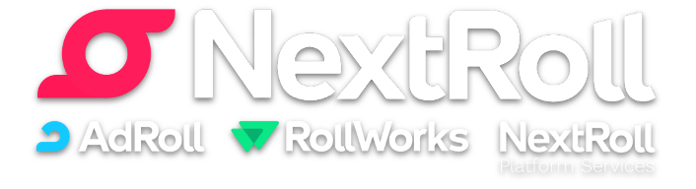
Amazon Lookout for Metrics
Automatically detects anomalies in business and operational time series data and identifies their root cause.
Detects anomalies faster and more accurately with ML and over 20 years of experience at Amazon.
Diagnoses likely issues at scale with greater confidence by providing actionable results.
Continuous improvement over time by incorporating human in the loop feedback.
Notes:
Amazon Lookout for Metrics is an anomaly detection service, which identifies outliers in business and operational metrics automatically, with root cause analysis and human-in-the-loop continual improvement.
“With Lookout for Metrics, we can quickly detect and analyze anomalies across our variety of data sources, trigger events if anomalies were found, and see the anomalies easily in the AWS console. Lookout for Metrics has saved our team many hours of manual investigation and notifications are viewed as actionable rather than noise, allowing our teams to easily focus on strategic priorities with less technical overhead.” -Mikhail Artyugin, Technical Director Playrix

Slide 56
AWS recognized as leader in Gartner Magic Quadrant for cloud AI developer services
This graphic was published by Gartner, Inc. as part of a larger research document and should be evaluated in the context of the entire document. The Gartner document is available upon request from AWS. Gartner does not endorse any vendor, product or service depicted in its research publications, and does not advise technology users to select only those vendors with the highest ratings or other designation. Gartner research publications consist of the opinions of Gartner's research organization and should not be construed as statements of fact. Gartner disclaims all warranties, expressed or implied, with respect to this research, including any warranties of merchantability or fitness for a particular purpose
Notes:
AWS was named leader in the first Gartner Magic Quadrant for Cloud AI based on Ability to Execute and Completeness of Vision.

Slide 57
Where to start
Notes:
While AI and machine learning technology is important to build successful machine learning initiatives, the organization culture is also important—ensuring you are ready to embrace transformation, that you have the skills in-house or can partner for expertise, experience and best practices.

Slide 58
Getting started on the journey
Training
Proof of Concept
Production
Notes:
AWS has a number of trainings and acceleration programs to help you get started on your journey
We offer in-person trainings for both technical and business stakeholders as well as a full free online training and certification program for your developers.
We can conduct workshops to help you identify the best use cases for your business and work hand and hand with your team to develop a proof of concept through the ML Solutions Lab. And through our AWS ML Embark Program, we do in-person training for both business decision makers and technical staff, ideation on use cases, and development of a proof of concept.
Lastly, we have a Professional Services team as well as ML partners who can do end to end development and take your machine learning application to production.

Slide 59



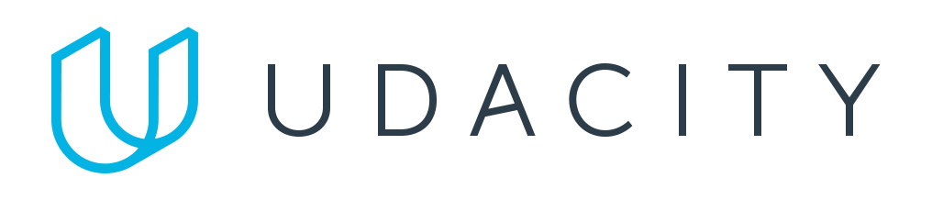
Building your team’s skills
Hands-on learning
Training + certification
AWS DeepRacer Reinforcement Learning
AWS DeepComposer
Generative AI
AWS DeepLens
Deep Learning
AWS ML Training and Certification
Partnerships with MOOCs
Notes:
In parallel, you want to focus on building the right skills for your engineers.
We sometimes hear that organizations don’t move ahead because they feel like they don’t have the technical expertise to be successful.
The truth is, you can’t buy your way in to talent. There’s not enough and it can get very expensive. Instead you have to focus on developing internal talent.
But, we have seen that developers are able to obtain the right skills with a high success rate when engaged with good, hands-on training.
Amazon developed a machine learning university that we have used for over six years to train our engineers on ML.
Last year, we made a lot of this content available for free to customers and we have seen well over 100,000 developers start their ML journey with these content since. Having strong training programs can also help you attract and retain talent.
We’ve also brought additional programs to market like DeepRacer and DeepLens to get aspiring ML developers hands on with the technology.
AWS DeepRacer provides developers with the opportunity to learn, upskill, and get hands on with ML through a fully autonomous 1/18th scale race car driven by reinforcement learning, 3D racing simulator, and global racing league.
We hold corporate events designed to provide developers with a fun way to get introduced to essential ML concepts. Customers like Accenture, MorningStar and Liberty Mutual.
AWS DeepLens is commonly used for object detection and sentiment analysis projects.
Models trained in Amazon SageMaker can be sent to AWS DeepLens with just a few clicks from the AWS Management Console.

Slide 60
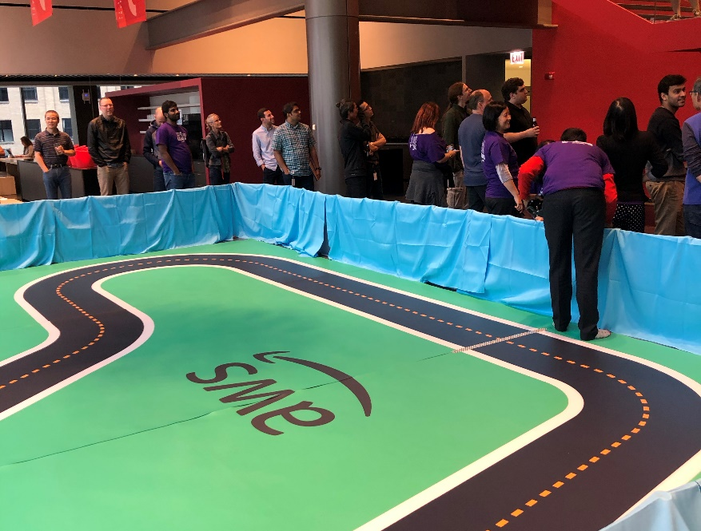

DeepRacer
Getting started with machine learning
Notes:
Morningstar uses AWS DeepRacer to provide hands-on training to their employees and accelerate their application of machine learning across its investing products, services and processes. More than 445 employees from multiple functions and 8 countries—including 35 percent of Morningstar's technology function—have been engaged in the AWS DeepRacer League.

Slide 61




The Amazon Machine Learning Solutions Lab
A range of ML engagements and use cases
Ideation through to production
Global footprint
Notes:
To help you identify a use case and bring it to proof of concept we have the Amazon ML Solutions Lab.
The ML Solutions Lab pairs your team with Amazon machine learning experts to prepare data, build and train models, and put models into production. It combines hands-on educational workshops with brainstorming sessions and advisory professional services to help you ‘work backwards’ from business challenges, and then go step-by-step through the process of developing machine learning-based solutions.
At the end of the program, you will be able to take what you have learned through the process and use it elsewhere in your organization to apply ML to business opportunities.

Slide 62

Introducing AWS Machine Learning Embark Program
DISCOVERY
Cross-functional workshops
TRAINING
In-person training
DEVELOPMENT
ML Solutions Lab
ENGAGEMENT
Get hands-on with DeepRacer
Notes:
The AWS machine learning Embark program is designed to start your company on the journey to machine learning success. The content is based on years of proven success helping organizations adopt ML, as well as Amazon’s own journey to put ML first in all areas of our business.
The program starts with an interactive workshop to identify the right business problem to tackle, followed by on-site, hands-on training to ramp up your company’s machine learning skills fast through practical application. Your developers then have the opportunity to partner with AWS machine learning experts from the ML Solutions Lab to build at least one proof of concept.
The program also includes a corporate AWS DeepRacer event to get your company motivated to embrace machine learning through hands-on friendly competition. With the practical skills, knowledge, and motivation derived from the program, your company will be ready to take your machine learning to the next stage.

Slide 63
ML.aws
Thank you!

Slide 64
Increase employee productivity by quickly and easily finding accurate information
“We introduce over 1200 new products every year. When our material scientists lead new research, they need access to information from prior relevant research—information that’s buried in the many patents we hold in our huge knowledge base. Finding the right information is often exhausting (but not exhaustive) and time-consuming.”
DAVID FRAZEE
Technical Director
Corporate Research Systems Lab
Amazon Kendra
Ask natural language questions, get immediate answers
Bring all of your data together in a few clicks
Constantly improving search results

Slide 65
Make it easy to identify fraudulent online activities
“We’re excited about the introduction of Fraud Detector because it means we can more easily use advanced machine learning techniques to accurately detect fraudulent reservations. Protecting our ‘front door’ from potential harm enables us to focus on making the vacation rental experience seamless and worry-free.”
ERIC BREON
Founder and CEO
Amazon Fraud Detector
Build high quality fraud detection ML models faster
Stop bad actors at the door
Built-in online fraud expertise
Give fraud teams more control

Slide 66
Analyze your rich media assets to increase value and create new insights from the content
“C-SPAN uses Amazon Rekognition to automatically index video news footage for search. With Rekognition, C-SPAN reduced indexing time per video from 1 hour to 20 minutes and uploaded 97,000 images in under 2 hours.”
IAN CLOUTIER
Technical Manager
Drive monetization through contextual ad placement and more
Reduce costs and improve productivity by automating key functions of the media supply chain
Avoid risk of displaying inappropriate content as well as creating branding issues
Amazon Translate
Amazon Rekognition
Amazon Transcribe
Amazon Comprehend

Slide 67
Add intelligence to your contact center to improve service and reduce cost
“We are now trialing the use of AI to gather information about the caller’s needs upfront. The operator sees that information on-screen and can offer a resolution right away. Operators enjoy being more helpful to callers and appreciate less repetition on the job”
CHRIS SUTER
Lead Cloud Architect
Reduce costs
Decrease time to resolution (TTR)
Reduce call wait times
Increase customer satisfaction
Improve employee satisfaction
Amazon Translate
Amazon Transcribe
Amazon Comprehend
Amazon Lex
Amazon Polly

Slide 68
Make personalized recommendations to increase customer engagement
“With the implementation of Amazon Personalize we are seeing, email CTR is up 67% over our control messaging. Rev/M Sends is up 49%, and because the content is even more relevant, our Opt out Rate has dropped 36%. But where the rubber hits the road for me is on revenue. Test emails have shown a 12.5% increase in revenue versus the control. It is clear that the AWS has given us another ‘arrow in our quiver’. My only regret is this capability didn’t exist two years ago when we started this journey.”
KRISTINA SMITH
Director Global Digital Marketing
Create high-quality recommendations
Own the moment with real-time recommendations
Personalize every touchpoint along the user journey
Deliver personalization within days, not months
Amazon Personalize

Slide 69
Make faster decisions by automatically extracting and analyzing data from documents
“Amazon Comprehend and Amazon Transcribe services allow VidMob to build high-quality machine learning text analysis into our Agile Creative Suite, enabling us to help brand clients understand content performance in ways never before possible. We are able to transcribe text from video content, and quickly analyze it using Comprehend, allowing us to surface actionable insights to both our creator community and our clients, giving them a strategic edge in the market.”
ALEX COLLMER
Founder and Chief Executive Officer
Get better answers from your text
Organize documents by topics
No code or templates to maintain
Lower document processing costs
Amazon Comprehend
+Medical
Amazon Textract

Slide 70
Forecast key demand metrics faster and more accurately to meet customer demand and reduce waste
“At CasaOne, we make sure our customers get access to their furniture in a few business days. In order to better predict how many couches CasaOne customers might rent in the Bay Area or how many coffee tables customers might rent in NY, we leverage the capabilities of Amazon Forecast. With Amazon Forecast, our sales prediction accuracy has improved by 20% compared to our existing forecasting algorithm. This means we can stock the right products and save on purchase costs worth a few thousand dollars. Improved product selection will also lead to enhanced customer experience in the long run."
MADHUSUDAN KAGWAD
Co-founder and Head of Products
Amazon Forecast
50% more accurate forecasts with machine learning
Reduce forecasting time from months to hours
Create virtually any time series forecast
Secure your business data and peace of mind

